Slide 1
Digital Portfolio
STUDENT NAME: V.Nandha
REGISTER NO AND NMID: 32724U18050,astvu32724034
DEPARTMENT: BSC, Computer science COLLEGE: COLLEGE/ UNIVERSITY:thiruvalluvar university

Slide 2
PROJECT TITLE
Interactive digital portfolio on codepen

Slide 3


AGENDA
Problem Statement
Project Overview
End Users
Tools and Technologies
Portfolio design and Layout
Features and Functionality
Results and Screenshots
Conclusion
Github Link
3/21/2024 Annual Review

Slide 4

PROBLEM STATEMENT
The current challenge is to create a responseive and interactive digital portfolio that showcases project effectively using codepen

Slide 5

PROJECT OVERVIEW
This project involves developing a digital portfolio hosted on codepen it allows showcasing coding skills, design creativity, and interactive features

Slide 6

WHO ARE THE END USERS?
Students Developers Recruiters Employers Educators

Slide 7

TOOLS AND TECHNIQUES
HTML CSS JavaScript Codepen platform GotHub(for version control

Slide 8
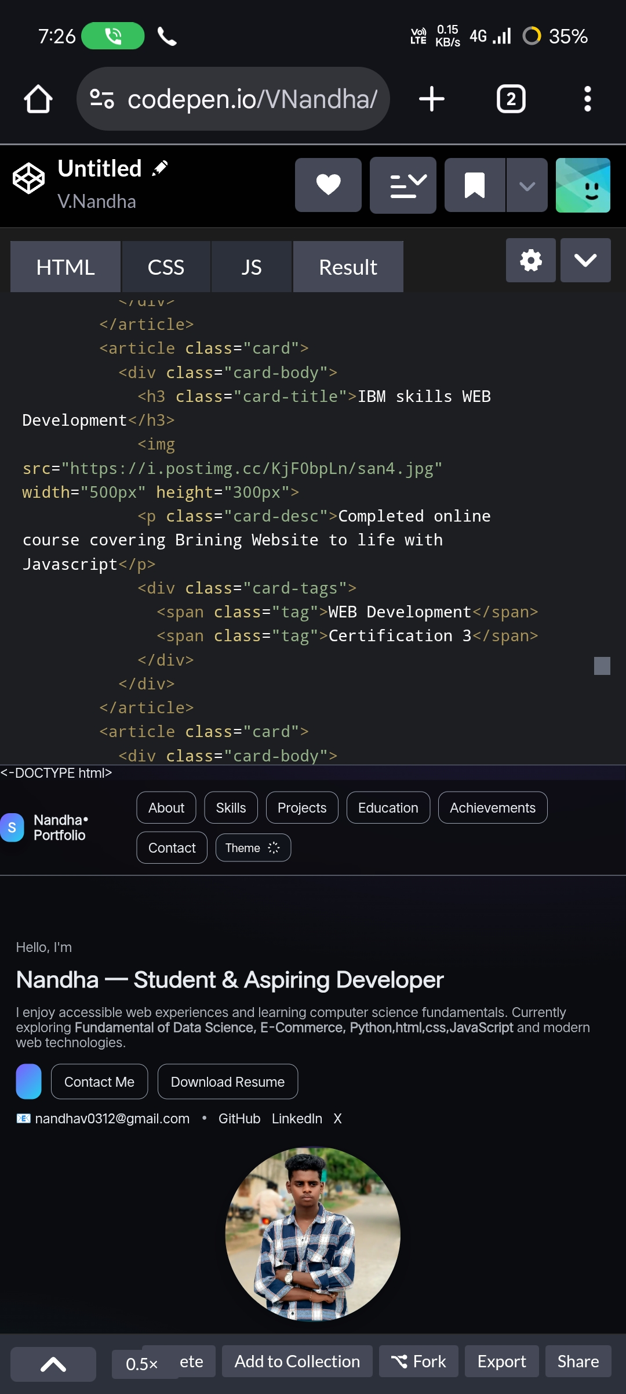
POTFOLIO DESIGN AND LAYOUT
8

Slide 9
FEATURES AND FUNCTIONALITY
Interactive project showcase Responsive layout Smooth navigation Integrated links to GitHub/Linkedin
Notes:
Interactive project showcase Responsive layout Smooth navigation Integrated links to GitHub/Linkedin

Slide 10
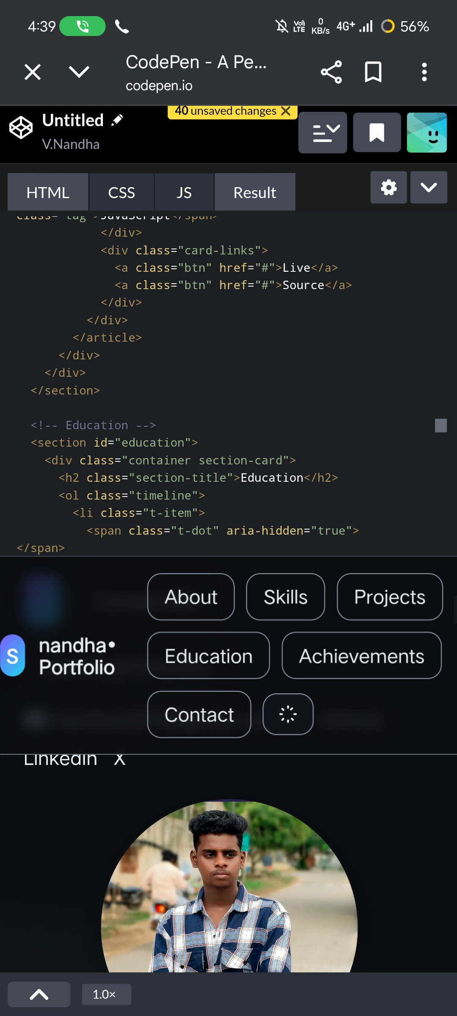

RESULTS AND SCREENSHOTS
3/21/2024 Annual Review
10

Slide 11
CONCLUSION
An Interactive portfolio on codepen effectively demonstrates coding abilities,project experience,and creativity
11

